Slide 1


Success on Windows: Developing Universal Windows
Platform apps for mobile
Andrew Moll Microsoft Technical Evangelist @AskTheData
Katherine Harris Microsoft Technical Evangelist @KatVHarris

Slide 2
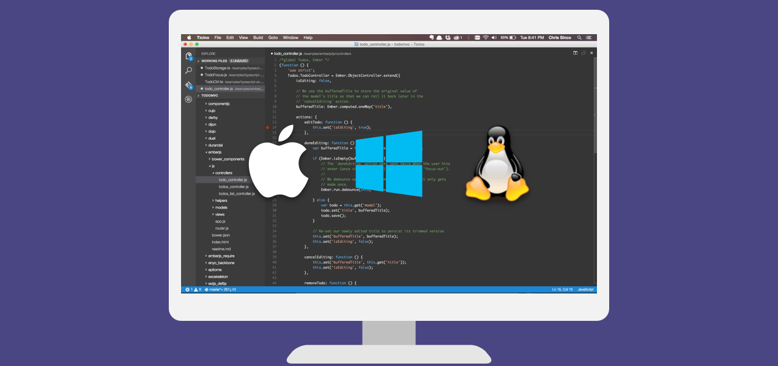
Visual Studio Code
Build and debug modern web and cloud applications.
Code is free and available on your favorite platform:
Linux, Mac OSX, and Windows.
C#, TypeScript, JavaScript, HTML, CSS, LESS, SASS, Python, JSON, CoffeeScript, Ruby, Jade, Clojure, Java, C++, R, Go, makefile, shell, powershell, bat, XML, Markdown
http://code.visualstudio.com

Slide 3
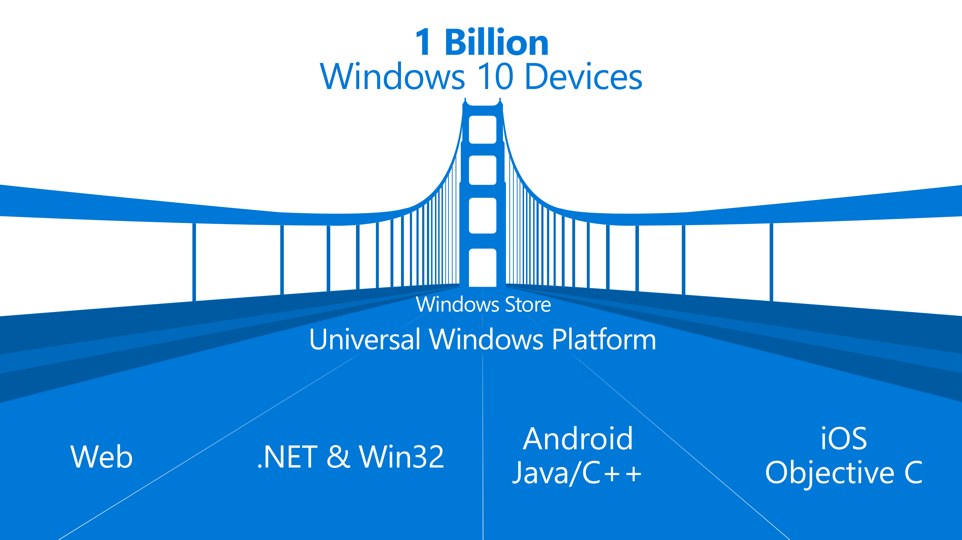

Slide 4

The convergence journey
Xbox 360
Xbox One
Unified core and app platform
Converged
OS kernel
Windows 8.1
Windows 8
Converged
app model
Windows 10
Windows Phone 8.1
Windows Phone 8
Easy for users to get & stay current
Windows Phone 7.5
Windows on Devices
Notes:
OS Kernal allowed for multi core etc. But win 8.1 had similar but not identical across. They were using Silverlight which we still don’t really use
Now nirvana with win 10 which is the truly converged dev platform.

Slide 5
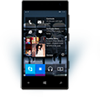

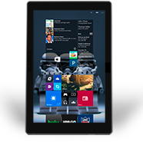
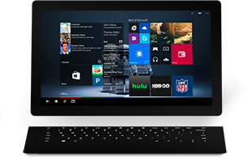

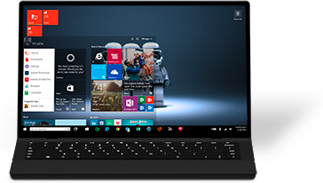

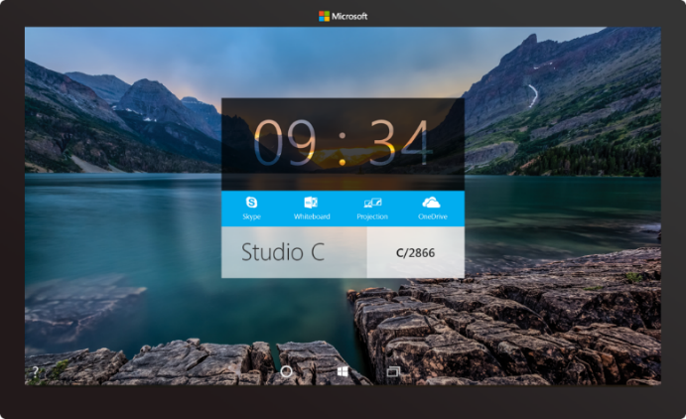

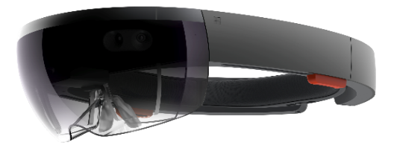



2-in-1s (Tablet or Laptop)
Classic Laptop
Desktops & All-in-Ones
Phone
Phablet
Small Tablet
Large Tablet
Windows 10
Surface Hub
Xbox
Holographic
IoT

Slide 6

Introducing the UWP

Slide 7
Windows Core
The refactored common core
One hardware platform
Universal hardware driver
Standard network and I/O
Windows App
Desktop SKU
Phone SKU
Xbox SKU
Universal Windows Platform
Windows Core
Desktop
Device
Phone
Device
Xbox
Device
Notes:
Windows core. What we install all over is really just the same version of windows.

Slide 8
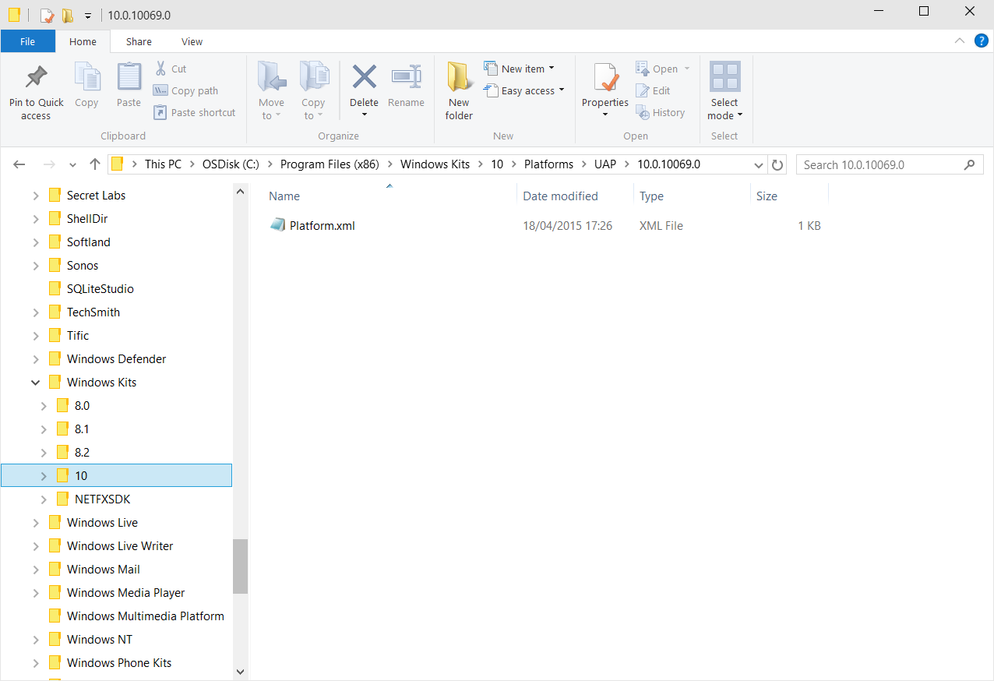
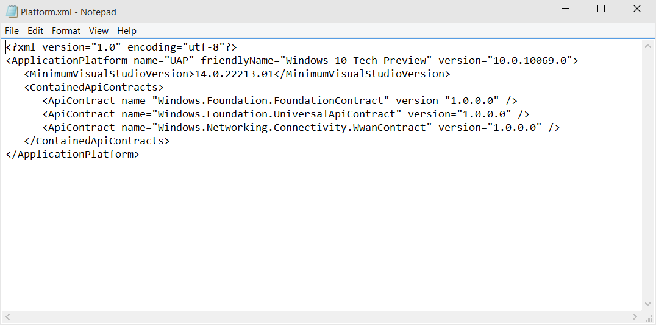
Universal Windows Platform
A single API surface
A guaranteed API surface
The same on all devices
Windows App
Desktop SKU
Phone SKU
Xbox SKU
Universal Windows Platform
Windows Core
Desktop
Device
Phone
Device
Xbox
Device

Slide 9
<TargetPlatform
Name="Microsoft.Universal"
minVersion="10.0.10069.0"
maxVersionTested="10.0.10190.0"/>

Slide 10
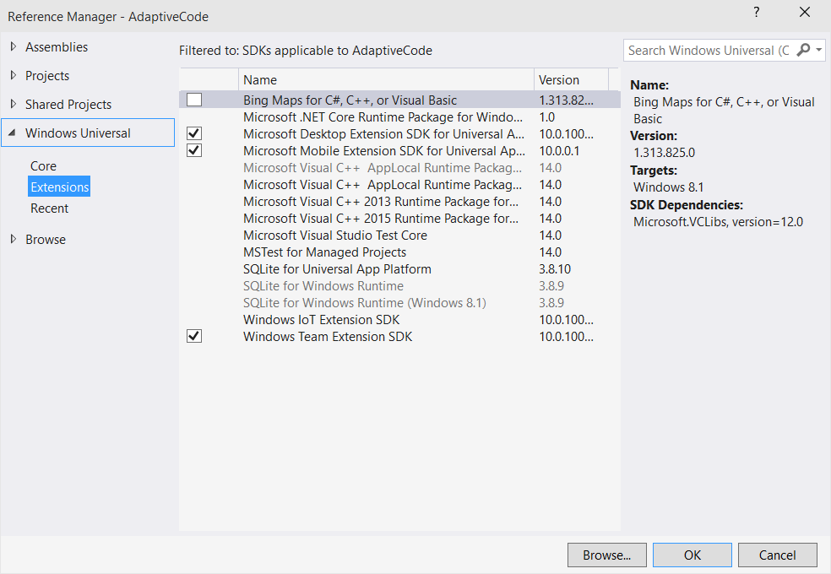
Platform extensions
Device-specific API
Family-specific capabilities
Compatible across devices
Unique update cadence
Windows App
Desktop
extension
Phone
extension
Xbox
extension
Universal Windows Platform
Windows Core
Desktop
Device
Phone
Device
Xbox
Device

Slide 11
One Windows
Desktop SKU
Mobile SKU
Xbox SKU
IoT SKU
IoT headless SKU
Surface Hub SKU
Holographic SKU
PC
2 in 1
Tablet
Phablet
Phone
Xbox
Band
Raspberry Pi
Surface Hub
HoloLens
Home Automation
Notes:
7 different products for now. We have the ability to bring in future products.

Slide 12
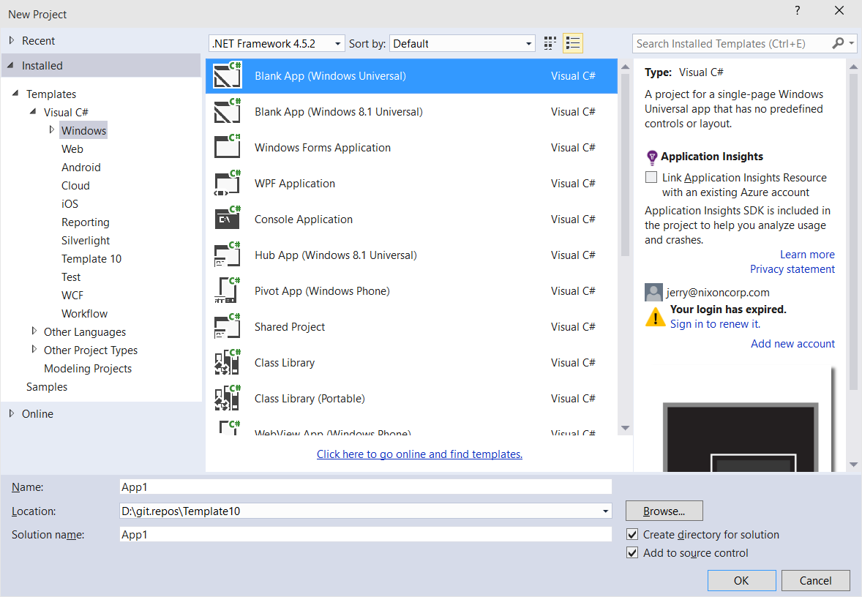
Windows app
A single binary
Running on any device
Testing for capabilities
Adjusting to devices
Windows App
Desktop SKU
Phone SKU
Xbox SKU
Universal Windows Platform
Windows Core
Desktop
Device
Phone
Device
Xbox
Device

Slide 13
Test capabilities at runtime
Use Adaptive Code to light-up your app on specific devices
var api = "Windows.Phone.UI.Input.HardwareButtons";
if (Windows.Foundation.Metadata.ApiInformation.IsTypePresent(api))
{
Windows.Phone.UI.Input.HardwareButtons.CameraPressed += CameraButtonPressed;
}
Notes:
Not a # if statement where if x build y but it’s actually the same app with a single bianary
And so that is the Universal Windows Platform

Slide 14
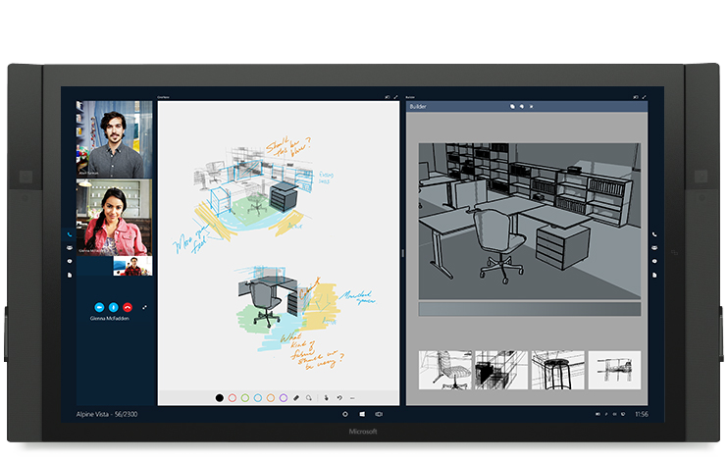
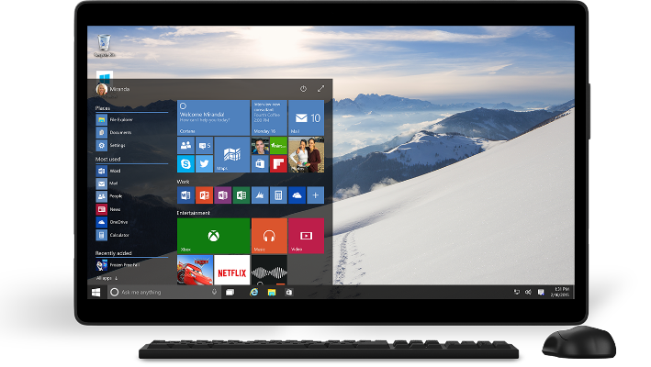
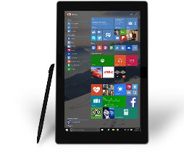
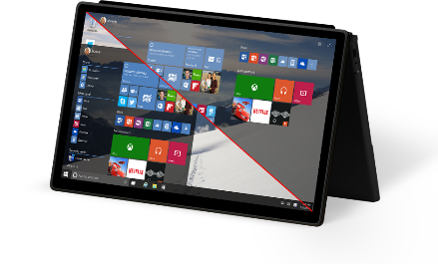
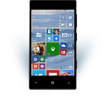
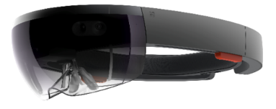
Universal Windows Platform
One Operating System
One Windows core for all devices
One App Platform
Apps run across every family
One Dev Center
Single submission flow and dashboard
One Store
Global reach, local monetization Consumers, Business & Education
Notes:
Dev enters are separate for win 8 and win phone. MSDN has now been converged as well.

Slide 15
Microsoft design language principles
Keep it Simple Isn’t it nice when things just work, when the next step is intuitive, and people are inspired? | Make it Personal We design for real people, not requiring people can fit into our design. Personal means human.
Think Universal Better technology for anyone is better technology for everyone. It’s an attitude. | Create Delight Attention of detail equals moments of delight. Sometimes delight is so perfect it is invisible.
Design as One Work together and do amazing things. Many teams, one ecosystem, happy customers.

Slide 16
For most text, use 15 epx Segoe UI Regular

Slide 17
Physical versus effective pixel
4” Phone
480x854
4” Phone
480x854
5” Phone
720x1280
5” Phone
720x1280
6” Phone
1080x1920
6” Phone
1080x1920

Slide 18
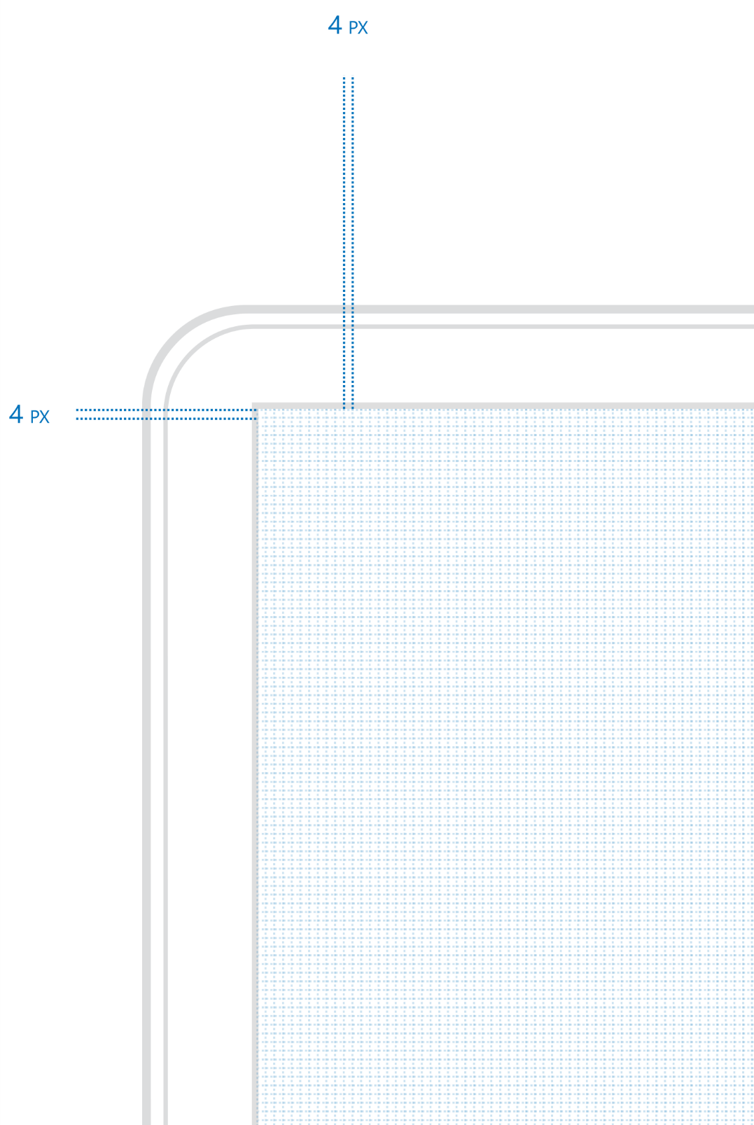
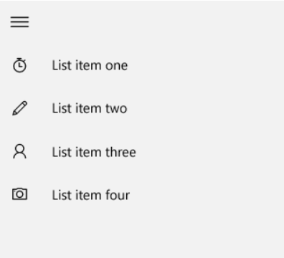
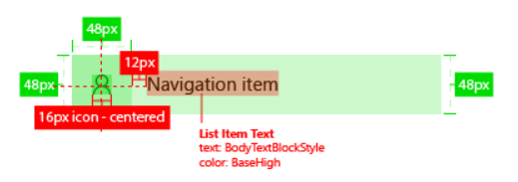
Four is the magic number

Slide 19
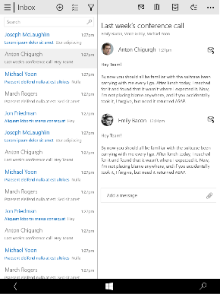
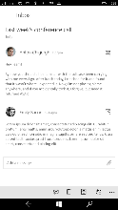
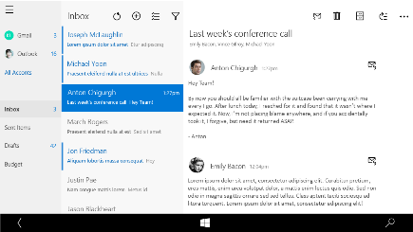
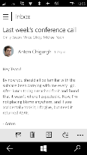
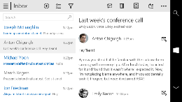
Snap points
epx
320
548
720
1024
phone
phablet & tablet
desktop
limited landscape support
one frame at a time
sys tray on the left
steering wheel on the right
4+ actions on the bottom
tabs are centered
limited landscape support
one frame at a time
sys tray on the left
steering wheel on the right
4+ actions on the bottom
single column stops scaling
tabs are centered
full landscape support
two frames
actions at the top
one “…” visible - TBD
tabs are left aligned
Show search field if search was represented as an icon on smaller devices
full landscape support
three frames
compact nav pane
actions at the top
one “…” visible
tabs left aligned

Slide 20
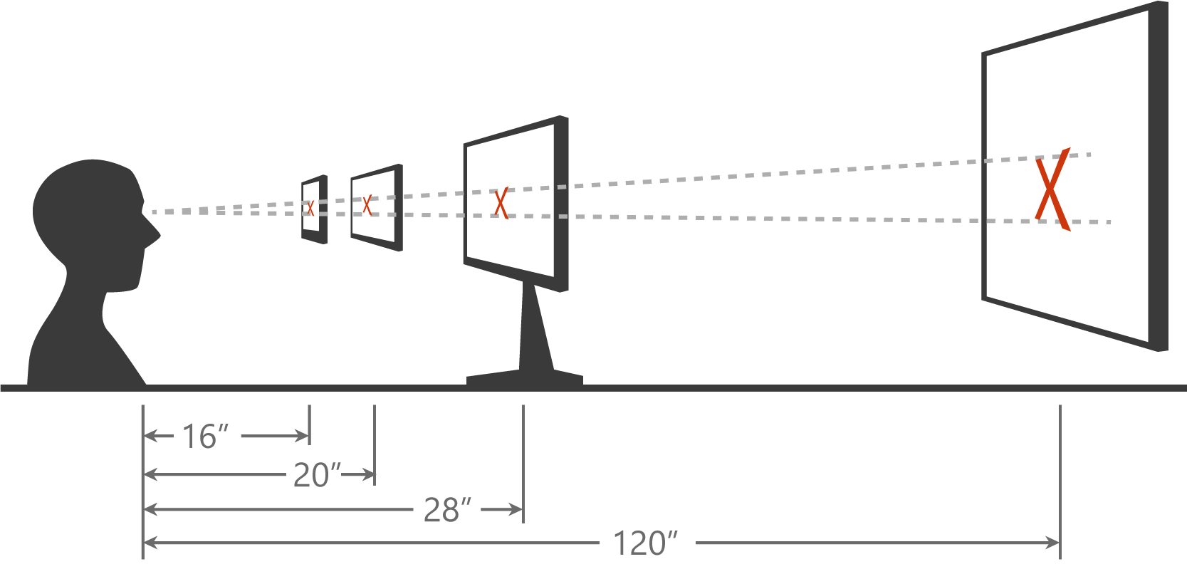
Scaling algorithm

Slide 21
As you design
Adapt to size change
Adapt to input change
Build with effective pixels
Count on the scaling algorithm

Slide 22
Techniques to adapt

Slide 23
Adaptive design
Responsive design
Flexible layout responds to small changes
Many controls handle basic responsiveness
Adaptive design
Smart layout adjusts to large changes
Features like visual states aid in this design
Tailored design
A device-specific app can simplify design
Some devices have unique design languages
Notes:
Responsive design: use % not pixels

Slide 24
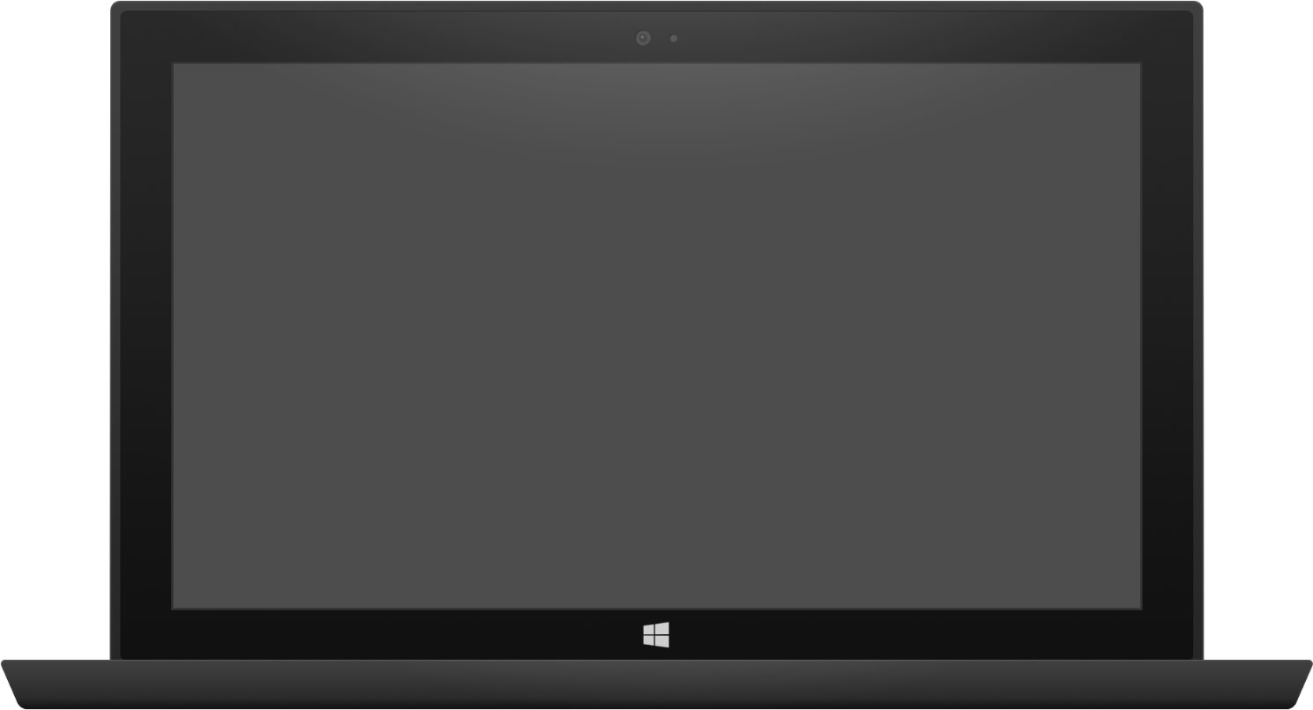

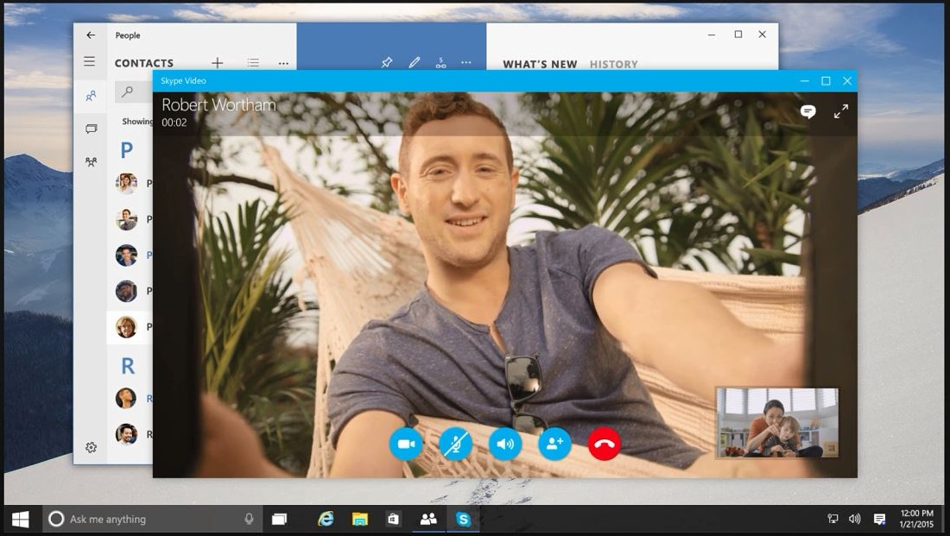
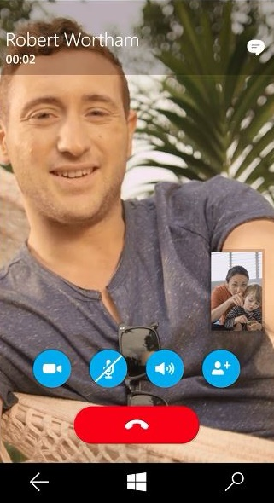
Adaptive design
Tablet (landscape) / Desktop
Phone (portrait)

Slide 25
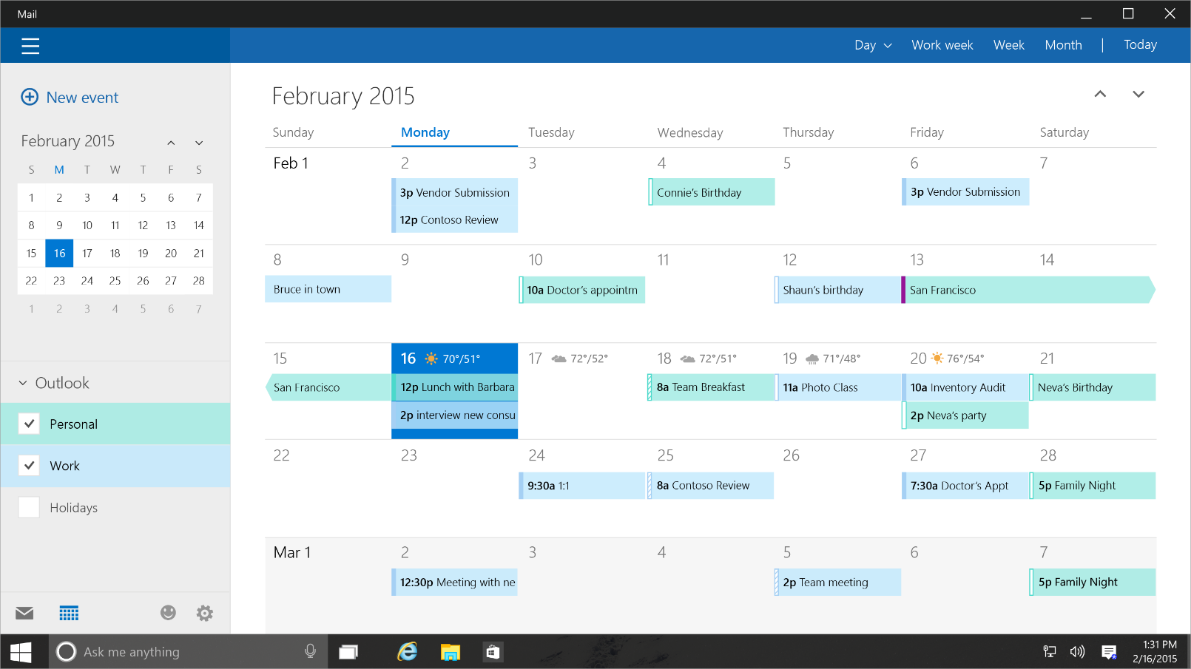
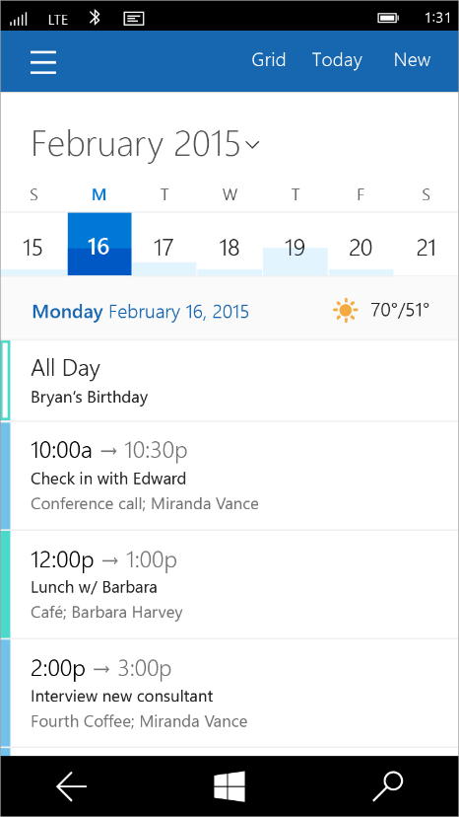
Tailored design
Tablet (landscape) / Desktop
Phone (portrait)

Slide 26
UI Layouts and Controls

Slide 27

Layout controls
<Border Thickness="" Brush="" />
<Canvas />
<Grid />
<RelativePanel />
<ScrollViewer />
<SplitView DisplayMode="" />
<StackPanel Orientation="" />
<VariableSizedWrapGrid />
<ViewBox Stretch="" />

Slide 28
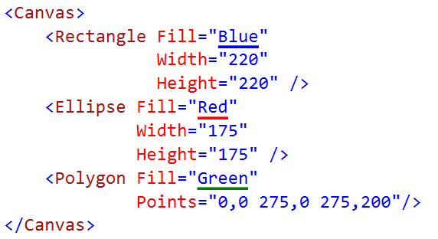

Canvas

Slide 29

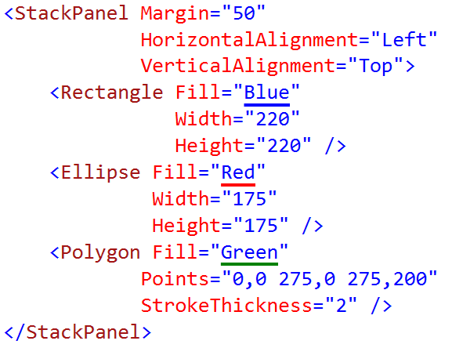
StackPanel

Slide 30
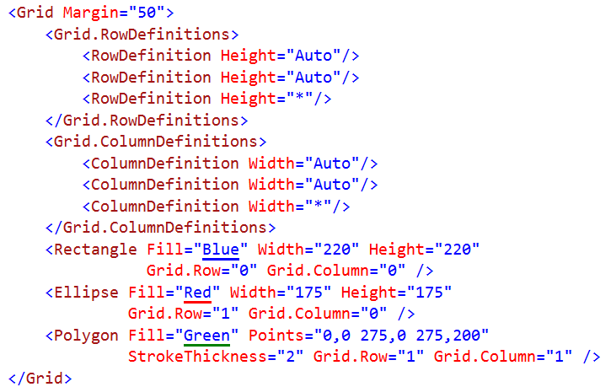
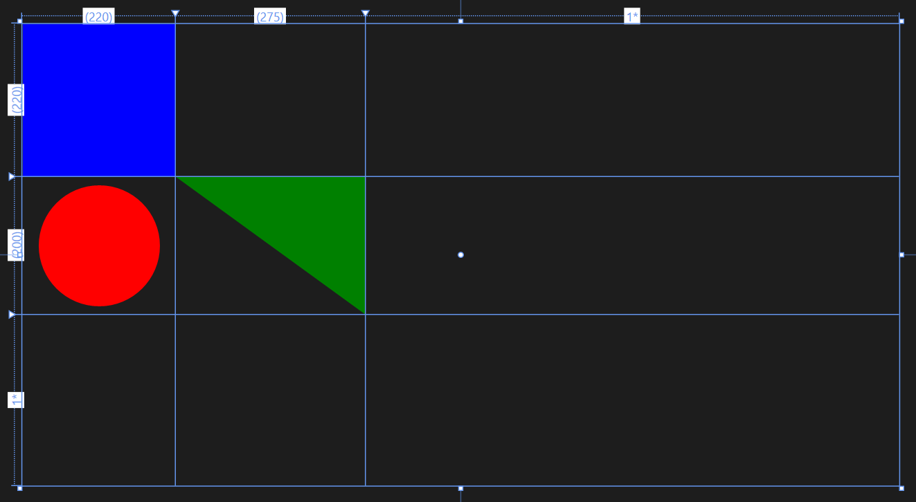
Grid
Notes:
3 rows and 3 columns
* Is to take the rest of the space available.

Slide 31
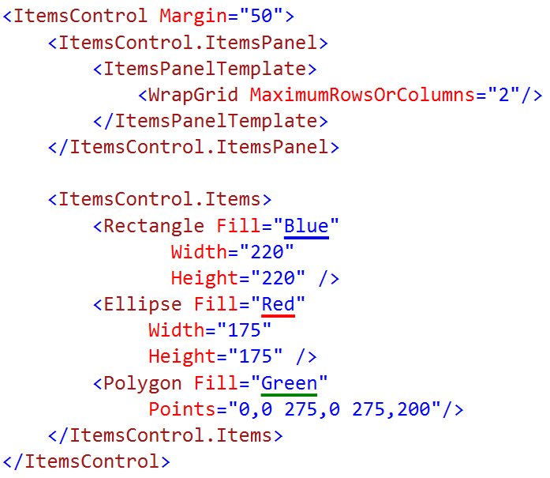

WrapGrid
Notes:
Each cell is defined by the first item put in. Can only really do this in a repeater control

Slide 32
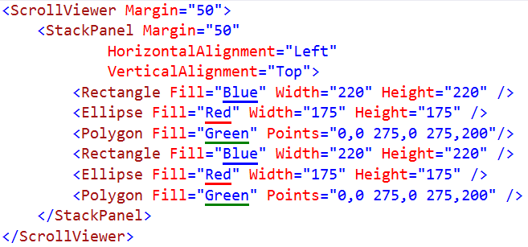
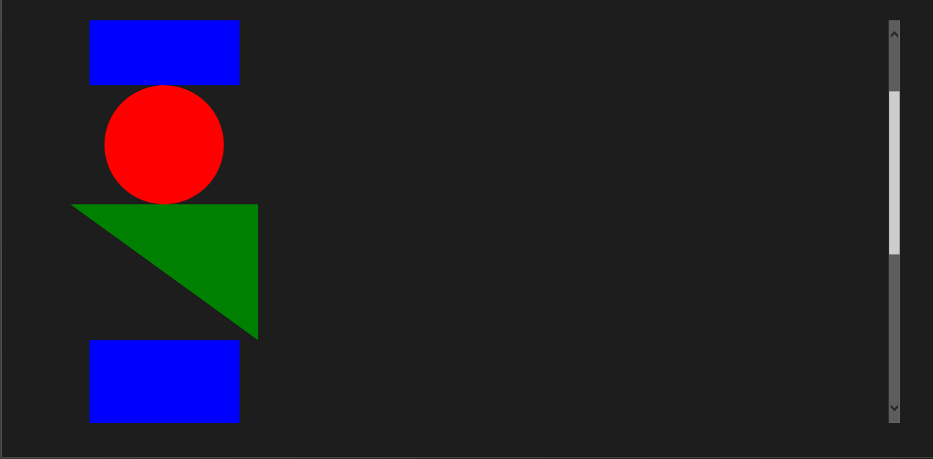
ScrollViewer
Notes:
This is jut a scroll bar

Slide 33
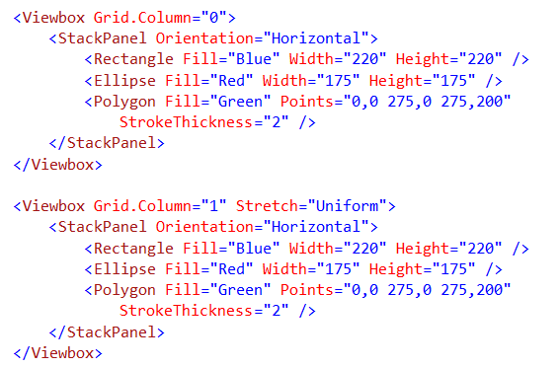
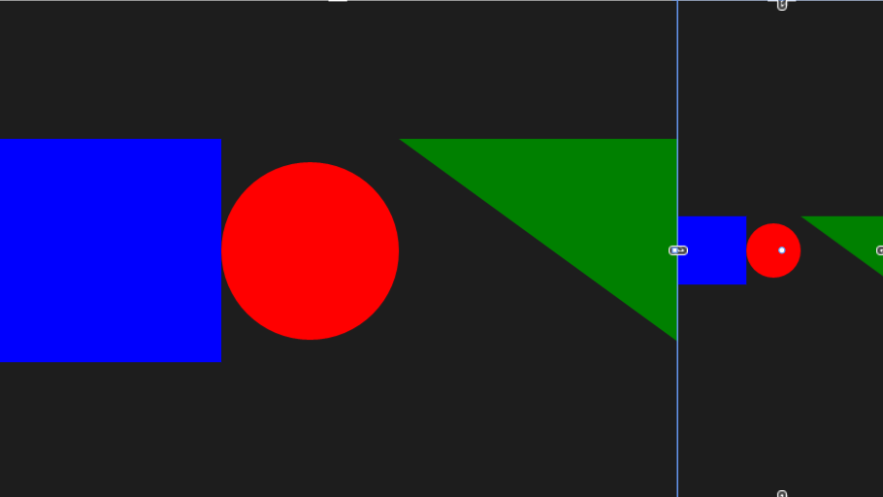
Viewbox
Notes:
View Box sizes things into the box.

Slide 34

RelativePanel
Some child elements act as anchors
Most child elements relate to others
It's a layout technique friendly with States
Notes:
Things are anchored to a specific panel. The old way would have been messing with different grids and moving it to empty cells. Messy

Slide 35
SplitView
 | IsPaneOpen="True" | IsPaneOpen="False"
DisplayMode= "Inline"
DisplayMode= "Overlay"
DisplayMode= "CompactInline"
DisplayMode= "CompactOverlay"

Slide 36
State Triggers
5 in Phone
4 in Phone

Slide 37
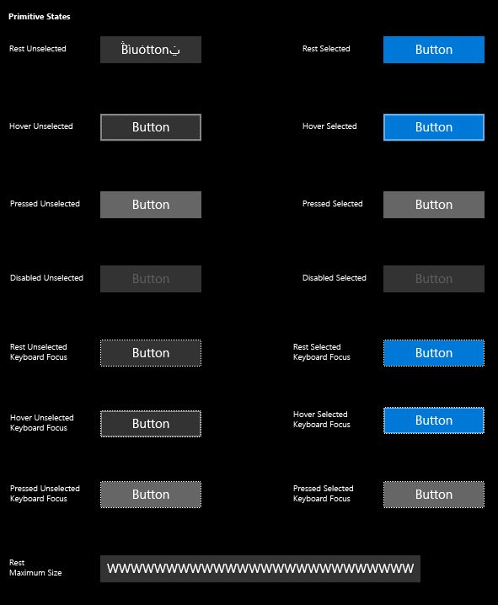
Buttons
<Button Content="" />
<HyperlinkButton />
<RepeatButton />
<ToggleButton IsChecked="" />

Slide 38
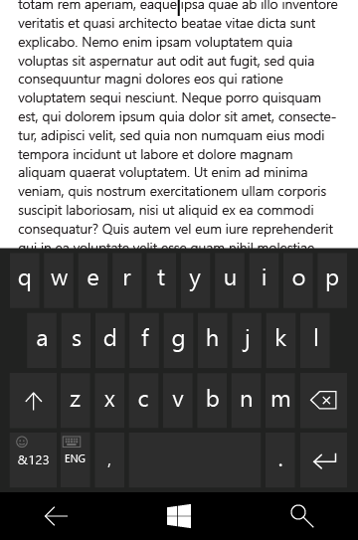
Text controls
<TextBox Text="" />
<PasswordBox Text="" />
<TextBlock Text="" />
<RichEditBox Content="" />
<RichTextBlock Content="" />
<BitmapIcon UriSource="" />
<FontIcon Glyph="" />
<SymbolIcon Icon="" />
<PathIcon Data="" />

Slide 39
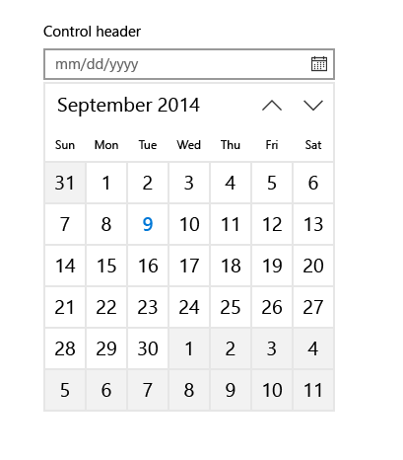
Selection and picker controls
<CalendarView />
<DatePicker Date="" />
<TimePicker Time="" />
<ToggleSwitch IsChecked="" />
<CheckBox IsCHecked="" />
<RadioButton IsChecked="" />
<ComboBox />
<ListBox />
<Slider Minimum="" Maximum="" />

Slide 40
Adaptive UI

Slide 41
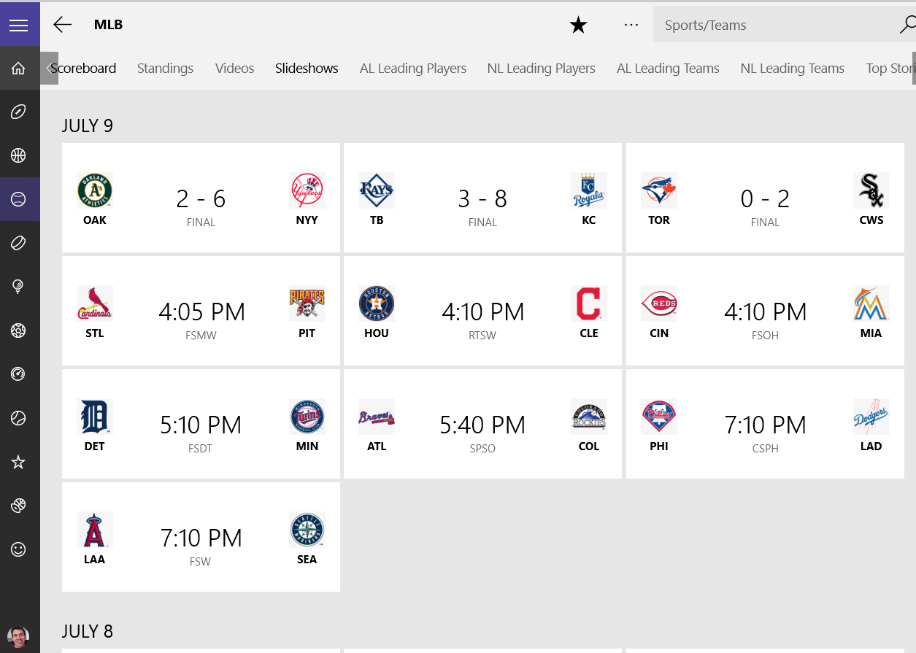
Notes:
Tab control/pivot? Probably navigation buttons in a stack panel
Splitview compact inline
List of stackpanels

Slide 42
Using standard controls gets you a long way

Slide 43
App Insights
App Insights enable developers to monitor app’s performance and usage statistics
Universal Windows project templates are enabled for App Insights and monitors app users, sessions, page view, crashes and real time usage without writing any additional code
Developers can easily add custom events to collect additional telemetry data for the app

Slide 44
Introducing “Template 10”
A new blank template
Includes a few files & empty folders to guide conventions
Similar to the MVC template
Add-on components to solve common problems
Solving for the 90%
The code will solve the 90% use case
Delivering with Windows 10
The template is in GitHub and still under construction

Slide 45
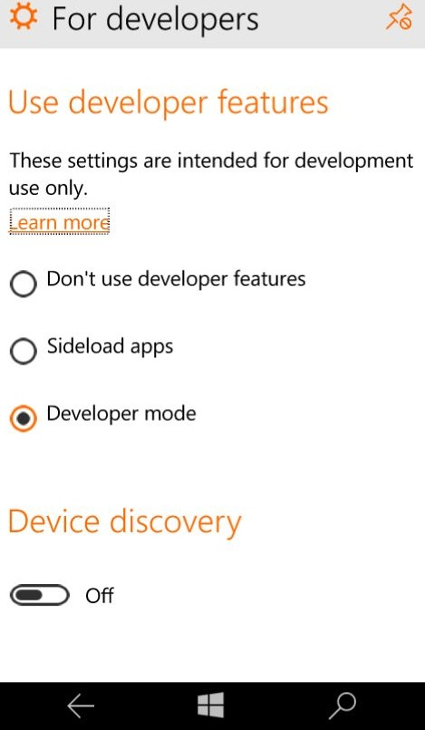
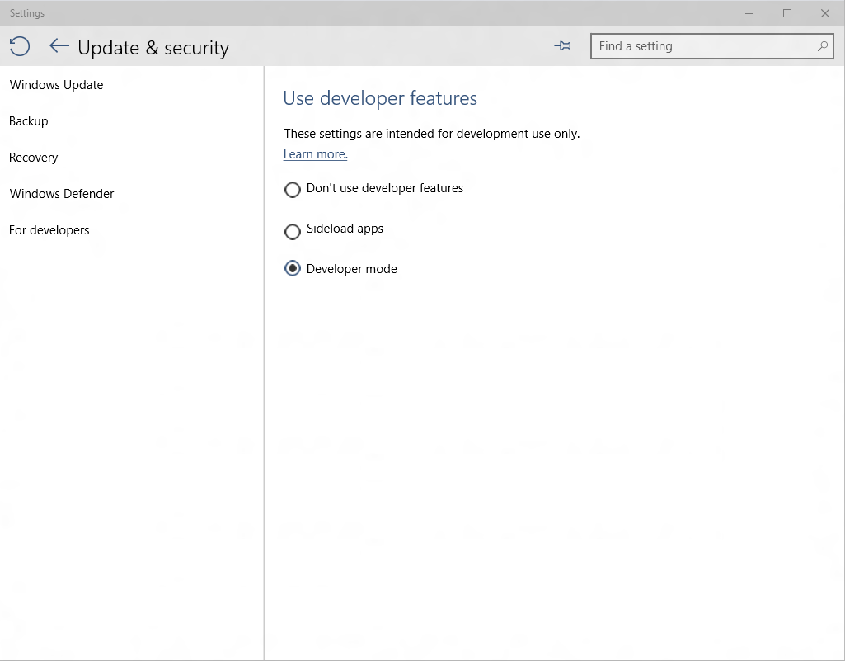
Developer unlock

Slide 46
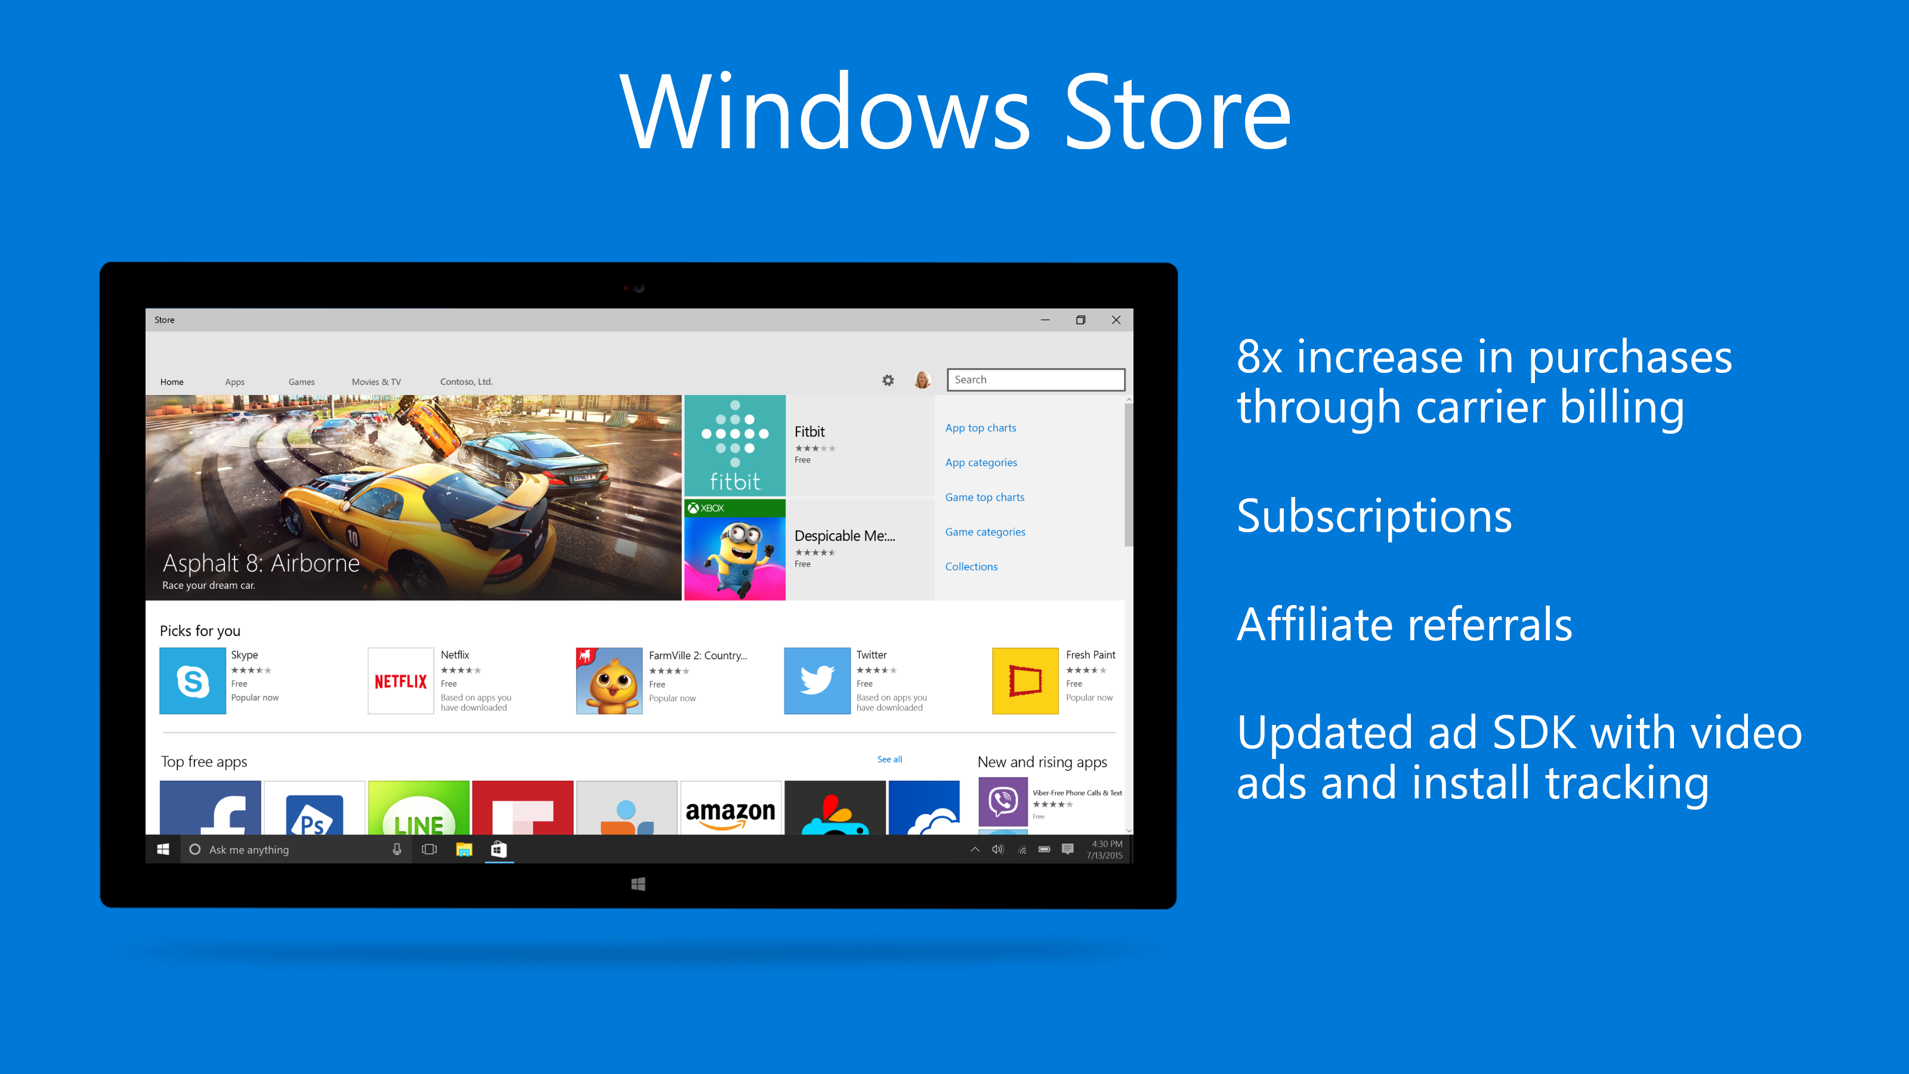
Notes:
Subscriptions: Ability to add subscription based apps
Affiliate: You can sell everything on your blogs and push those through the windows store
Mobile purchasing option. One store for everything!
Ability to do house ads! Can do ads on your dev blog for your applications

Slide 47


Online Microsoft training delivered by experts to help technologists continually learn
Hundreds of courses for developers, IT Pros, students, entrepreneurs and enthusiasts
11 different languages
3M students registered
Build your own Learning Plan
All free!
http://www.microsoftvirtualacademy.com

Slide 48
Technical Resources for Windows Devs
Visual Studio Community Edition (free): http://aka.ms/vsc2013
Ultimate Guide & FAQ to Setting-up a Windows Phone Dev Environment: http://aka.ms/wpdevsetup
Building Apps for Windows Blog: http://blogs.windows.com/buildingapps
Dvlup Challenges & Rewards: www.dvlup.com
Microsoft App Studio: http://appstudio.windows.com
Nick Landry’s Blog: www.AgeofMobility.com
Windows Phone Developer Magazine (online): http://flip.it/95YFG
Windows Phone 8.1 Jump Start Training: http://aka.ms/wp81js
Windows 8.1 Universal Apps Samples Pack https://code.msdn.microsoft.com/windowsapps/Universal-Windows-app-cb3248c3

Slide 49


Thank You!
Contact us and tell us about what you build! We will be happy to help promote your projects!
Blog: www.AndrewSMoll.com
Twitter: @AskTheData
Email: Andrew.Moll@microsoft.com
LinkedIn: www.linkedin.com/in/andrewmoll
GitHub: github.com/AndrewMoll
Blog: https://www.linkedin.com/in/katvharris
Twitter: @KatVHarris
Email: Katherine.Harris@microsoft.com
LinkedIn: www.linkedin.com/in/katvharris
GitHub: github.com/katvharris

Slide 50
MEET THE TEAM
Christine Matheney Technical Evangelist
Livi Erickson Technical Evangelist
Andrew Moll
Technical Evangelist
Doris Chen Technical Evangelist
Gabrielle Crevecoeur Technical Evangelist
Tim Reilly Technical Evangelist
Tobiah Zarlez Technical Evangelist
Jeremy Foster Technical Evangelist
Katherine Harris Technical Evangelist
Beth Massi Program Manager
Annie Bubinski Community Evangelist
Jennelle Crothers Technical Evangelist
Robin Shahan Content Developer
Vanessa Diaz
Business Administrator
Joe Shirey
Tech Evangelism Director

Slide 51
MEET OUR MVPs
Jeremy Clark
.NET MVP
Joe Reynolds
.NET MVP
Vishal Saxena
Azure MVP
John-Daniel Trask
ASP.NET/IIS MVP
Ami Levin
SQL Server MVP
Deborah Kurata
.NET MVP
Sumant Tambe Visual C++ MVP
Ryan Riley
.NET MVP
Craig Berntson
.NET MVP

Slide 52
MAKE THE MOST OF YOUR EXPERIENCE
Microsoft Azure Essentials – Fundamentals of Azure book giveaway for survey completion while supplies last
Hardware raffle Sunday (Microsoft Bands and Dell Inspiron 2-in-1)
Complete the survey for the chance to win -> aka.ms/SVCC
Visit our booth
Play with some cool devices, like the Surface Pro 3 and Lenovo Yoga 3 Pro
Connect with our speakers

